Slide 1
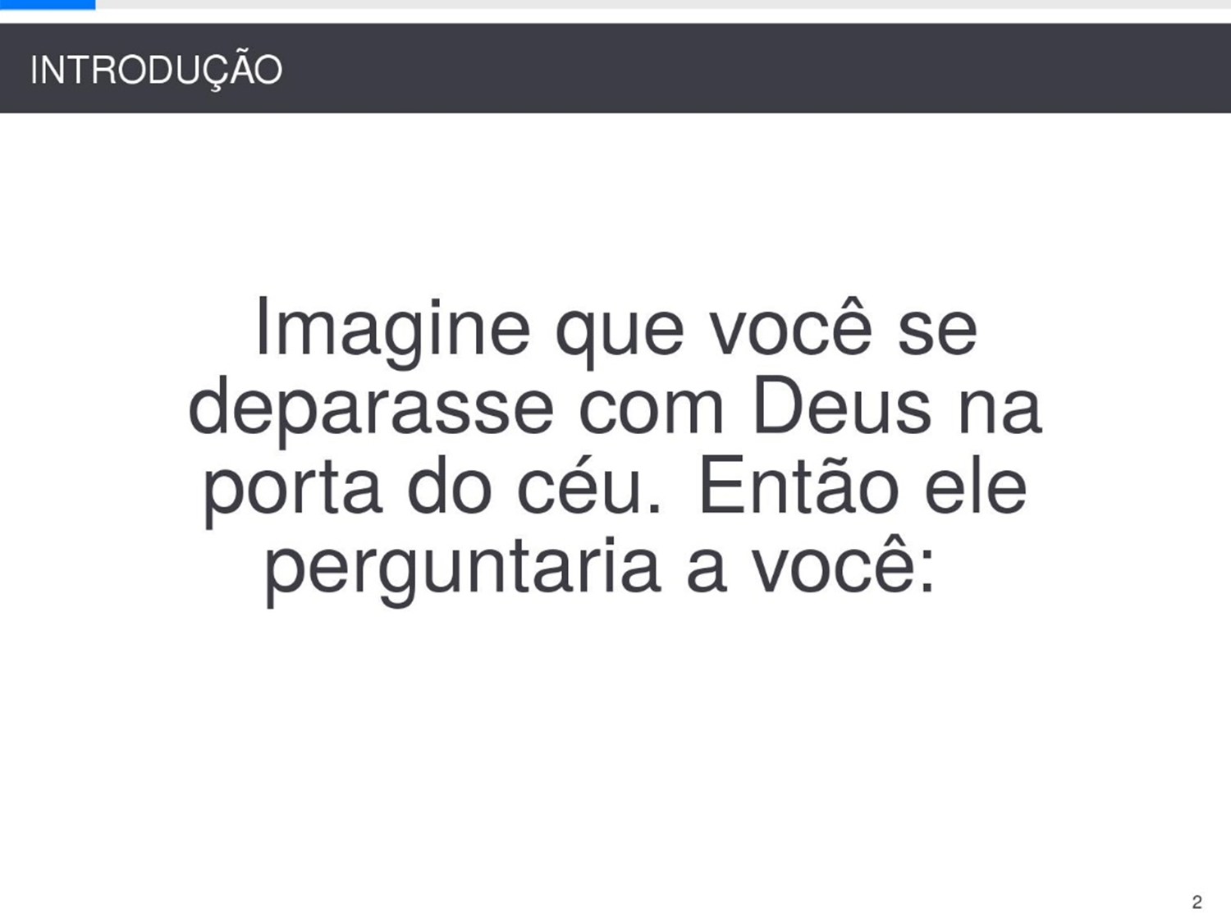
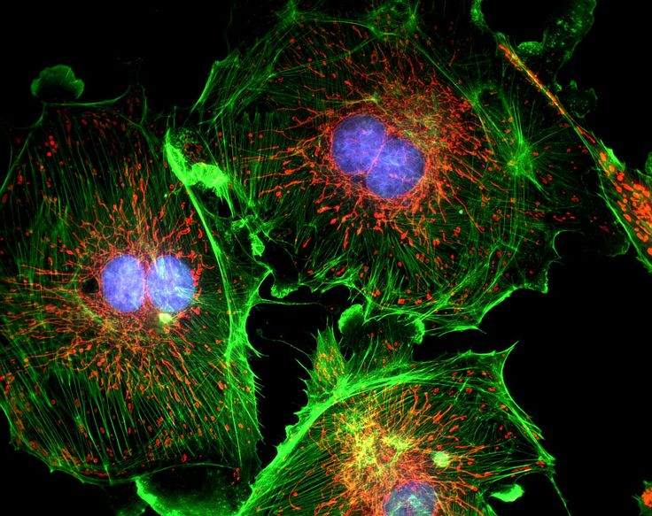
FPGA-based fluorescence microscope
Bring real time to multi-channel microscope.
Yi Zhang
Zhihao Yuan
Tianzhi Wu
zhangyi@bu.edu

Slide 2
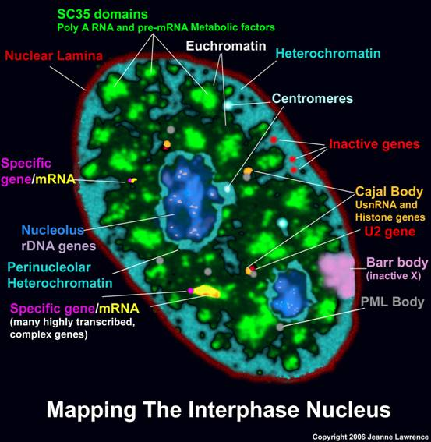
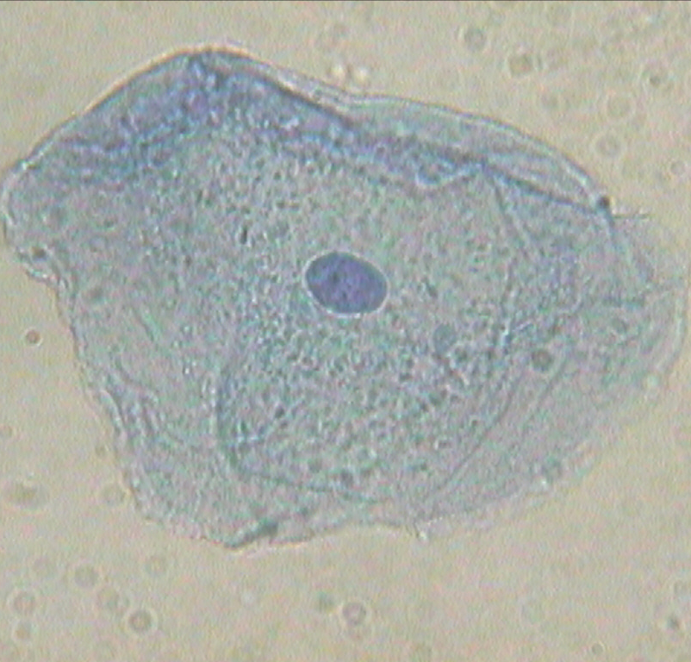

What is fluorescence microscope and why it is important
Chemical components of cell ordinary microscope fluorescence microscope
The cell is a very complex system includes lots of different chemicals.
However, ordinary microscope can not provide us with the chemical component information.
Fluorescence microscope provide us with a way to understand the chemical composition of cell in-vivo.
The color of fluorescence microscope are not real color, they are pseudo color used to distinguish different chemical components.

Slide 3
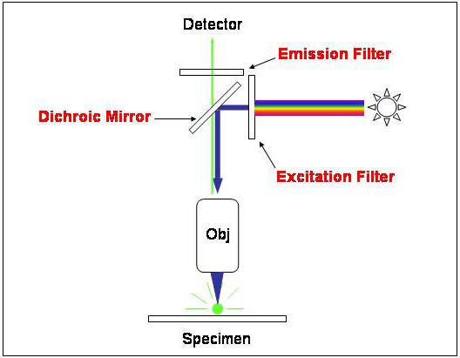
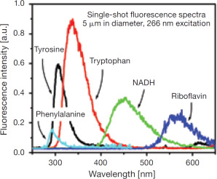
How dose the fluorescence microscope work
Set up of fluorescence microscope
Fluorescence spectrum
When molecular absorb a photon, some kind of them will emit a photon with longer wavelength.
Different molecular emit different wavelength photon. When we get different kind photon, we can tell which molecular is there.

Slide 4
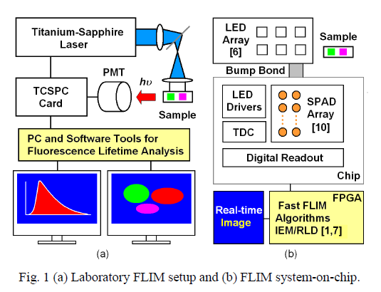
Why FPGA can help
A real fluorescence microscope system is complex and slow.
Problem of niose.
The FFT could make spectrum faster.
The FPGA can meke the calculation faster.
Real time imaging if possible.
Pelet, S., et al. "A fast global fitting algorithm for fluorescence lifetime imaging microscopy based on image segmentation." Biophysical journal 87.4 (2004): 2807-2817.

Slide 5


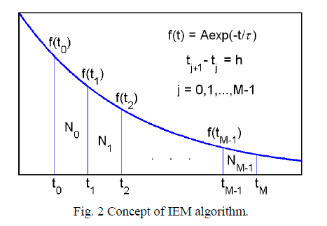
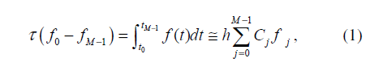
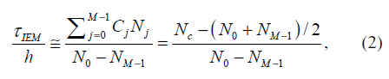
Concept of Algorithm

Slide 6
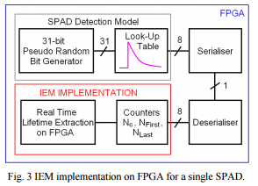
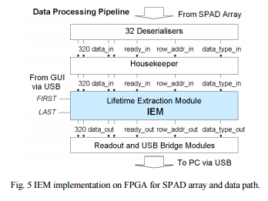
FPGA implementation
As a semester project, start from nothing may be too hard.
In the cited paper, they proposed the implementation of the FPGA to achieve the image processing.
We hope to make it and add our improvement to it.
Li, Day-Uei, et al. "FPGA implementation of a video-rate fluorescence lifetime imaging system with a 32x32 CMOS single photon avalanche diode array." (2009).

Slide 7
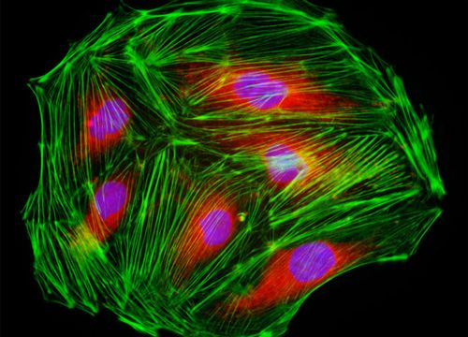
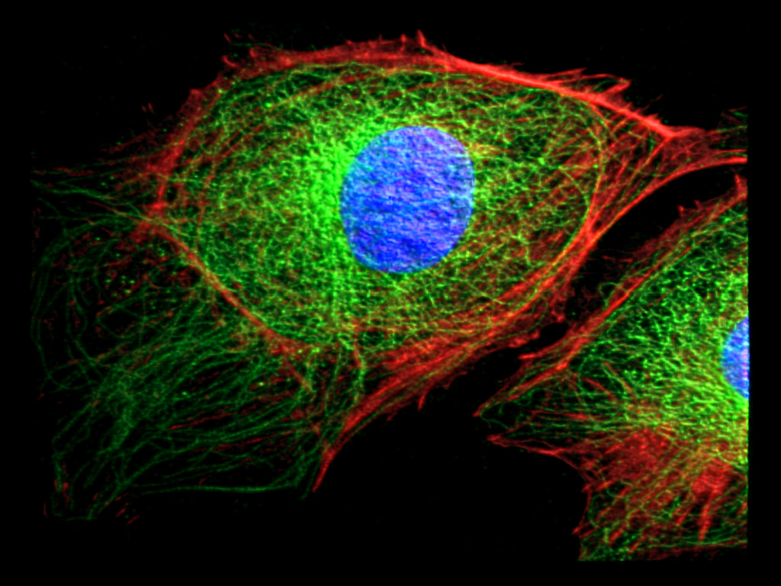
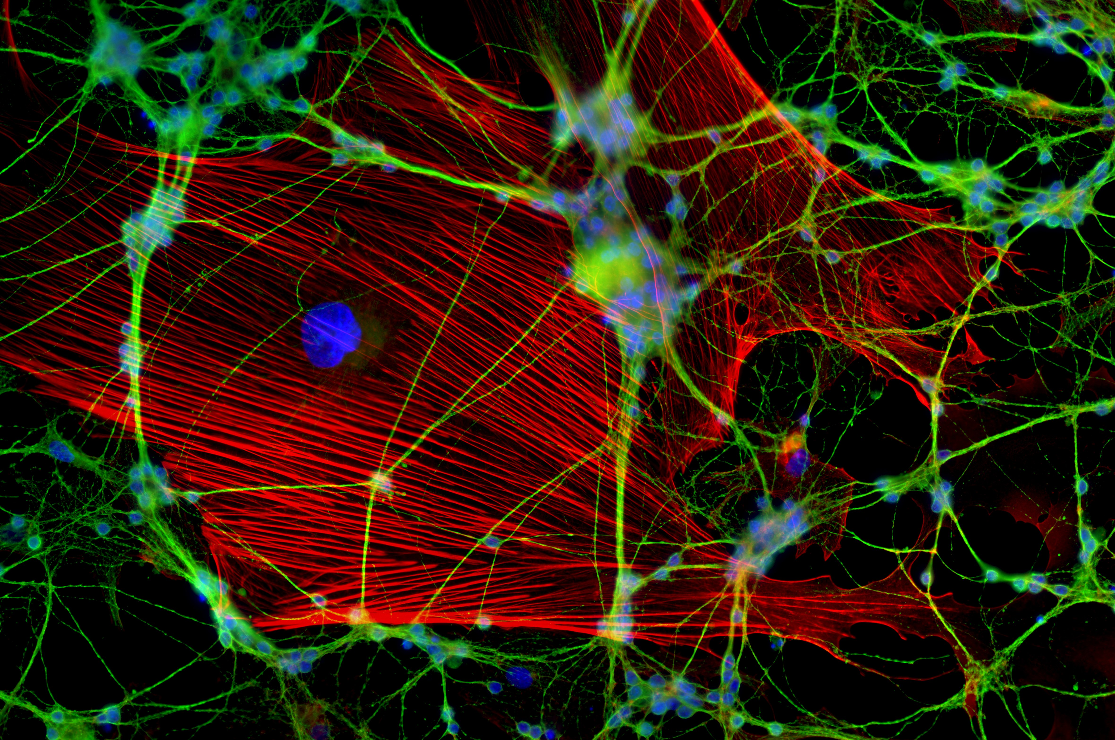
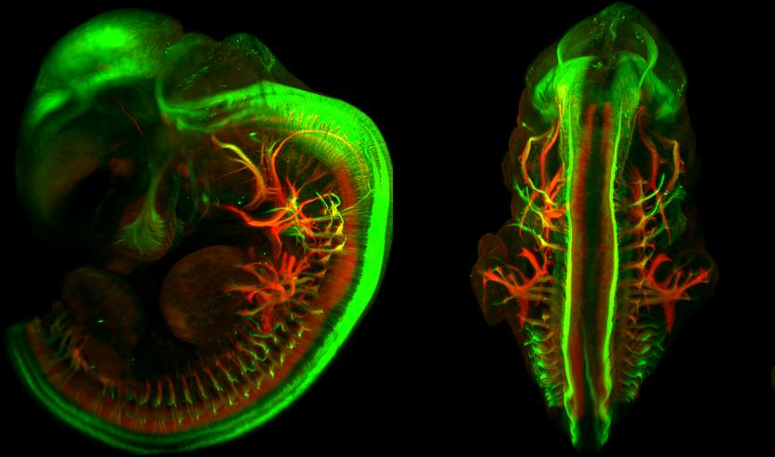
Fluorescence microscope images

